Slide 1
ENPM 808A: Data Driven Motion Planning
Saketh Narayan Banagiri

Slide 2
Introduction
Robot navigation entails the ability of a robot to establish its location within its frame of reference and plan a route to reach its desired location.
Path planning is a crucial element of autonomous mobile robot navigation.
It involves generating a map of the environment through the analysis of sensor data, which entails intensive computational processing.
To minimize this computation, this project proposes a data-driven motion planning approach.

Slide 3
Problem Statement
The goal of this project is to develop a machine learning model for a four-wheeled toy car with non-holonomic constraints, as it navigates through corridor and box environments using real-time sensor data collected through laser scanning.

Slide 4
Given Data
The data is organized into columns as follows:
First 1080 columns represent the laser range data.
Next 4 columns represent final goal information.
Next 4 columns represent the local goal information.
Next 4 columns represent the robot's current position and pose information.
Final 2 columns represent the commanded actions.

Slide 5
Feature Extraction
Reduced Laser data from 1080 columns to 12 columns
The goal and orientation information are reduced to 8 columns from 12
In total, the number of columns were reduced to 22 from 1094

Slide 6
Data Splitting
The data was already separated into training and test sets.
Further, I have separated the training set with a split of 0.1 to compare training and validation losses for my final model.

Slide 7
Final Model Selection
Based on the mean absolute errors, I chose to use CNN as the final model.
Machine Learning Pipeline | Mean absolute error
Linear Regression | 0.24189557811305168
Support Vector Regression | 0.26905703357030397
Gradient Boosting Regressor | 0.20074039777749236
Convolutional Neural Network | 0.18509529328224894

Slide 8
Hyper parameter tuning
The following hyperparameters were adjusted.
Depth: Increased the number of layers and nodes. Used 6 layers in total.
Batch size: Iterated the algorithm for various values of batch size.
Epochs: Iterated the algorithm for various values of epochs and it was finally set to be 100
Implemented L1 Regularization in the initial layer of the neural network to correct the over fitting.

Slide 9
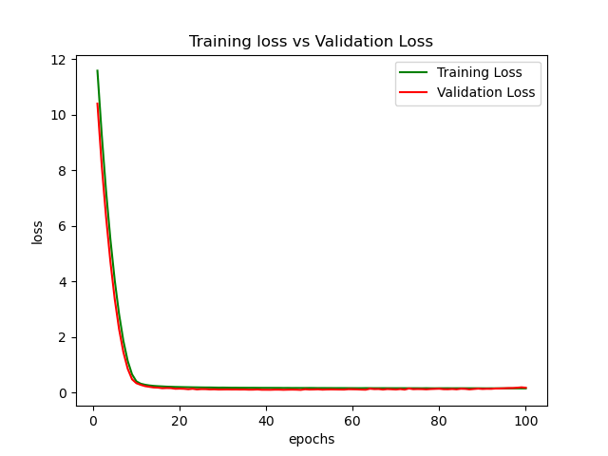
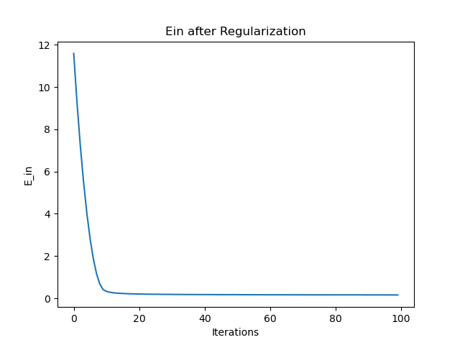
Final Model
The Final model is a CNN of 6 layers.
Ein_train = 0.14334958132026288 Ein_test = 0.17088120598505221
Implemented L1 regularization to avoid overfitting.
The plots shown are the ones obtained after L1 regularization.

Slide 10
Generalization using Hoeffding’s Inequality
The total number of test examples (N)= 12, 220.
considering δ = 0.05% i.e. 95% probability, we get :
E_{o}<= 0.01228

Slide 11
Conclusion
Successfully developed a machine learning model for a four-wheeled toy car with non-holonomic constraints, using Data-Driven Motion Planning approach using Convolutional Neural Networks.

